Slide 1
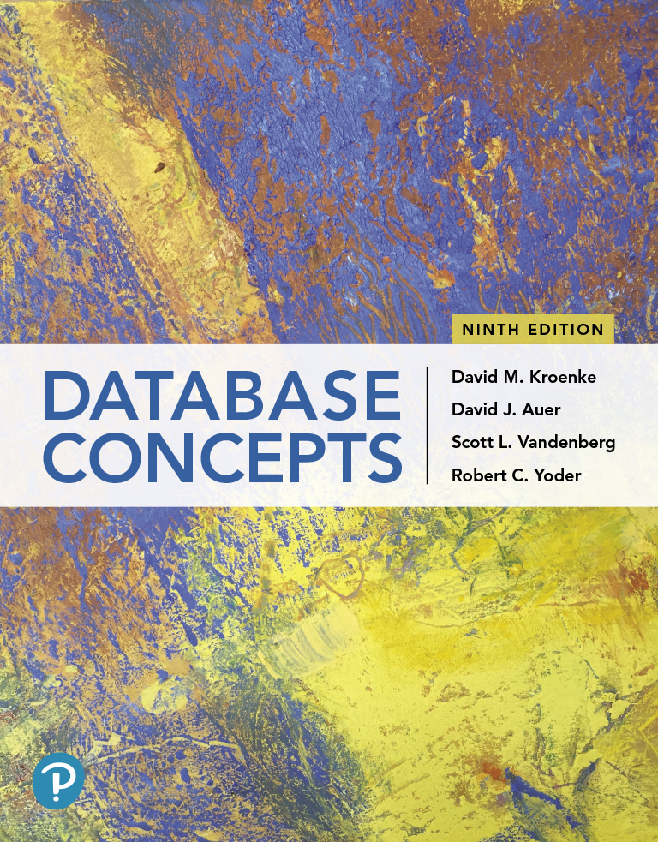
Database Concepts
Ninth Edition
Chapter 1
Getting Started
Copyright © 2020, 2017, 2015 Pearson Education, Inc. All Rights Reserved
Notes:
If this PowerPoint presentation contains mathematical equations, you may need to check that your computer has the following installed:
1) Math Type Plugin
2) Math Player (free versions available)
3) NVDA Reader (free versions available)

Slide 2
Learning Objectives (1 of 2)
Understand the importance of databases in Internet Web applications and mobile apps
Understand the nature and characteristics of databases
Understand the potential problems with lists
Understand the reasons for using a database
Understand how using related tables helps you avoid the problems of using lists
Know the components of a database system
Learn the elements of a database
Learn the purpose of a database management system (D B M S)
Understand the functions of a database application

Slide 3
Learning Objectives (2 of 2)
Introduce Web database applications
Introduce data warehouses and business intelligence (B I) systems
Introduce Big Data and cloud computing

Slide 4
The Importance of Databases in the Internet and Mobile App World
Understand the importance of databases in Internet Web applications and mobile apps
The Internet was created as the A R P A N E T in 1969 and grew to connect L A N s.
It became known and used when the World Wide Web (Web) became accessible in 1993.
In the early 2000s, Web 2.0 sites started to appear allowing users to add content.
The Internet of Things (I o T) is the latest development which allows all types of devices to connect with each other.
All of these items depend upon databases.

Slide 5
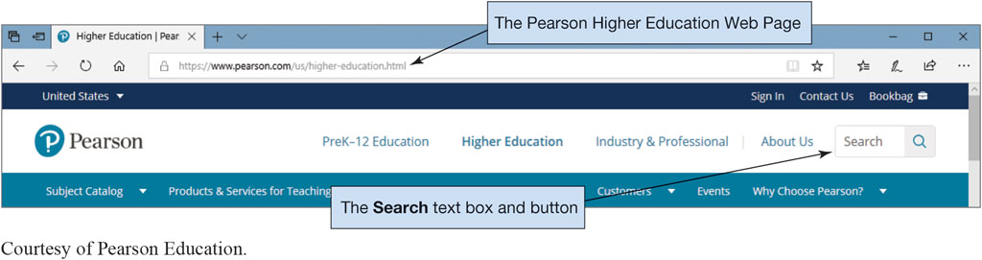
Figure 1.1(a) Searching a Database in a Web Browser
Courtesy of Pearson Education

Slide 6
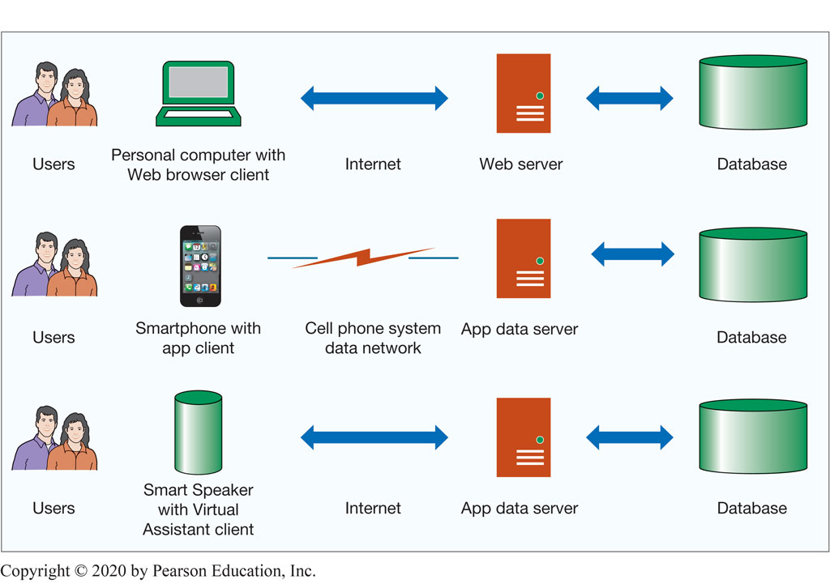
Figure 1.2 The Internet and Mobile Device World

Slide 7
Why Use a Database?
Understand the nature and characteristics of databases
The reason databases are used is to keep track of things.
Databases store more complicated information than simple lists like a spreadsheet.

Slide 8
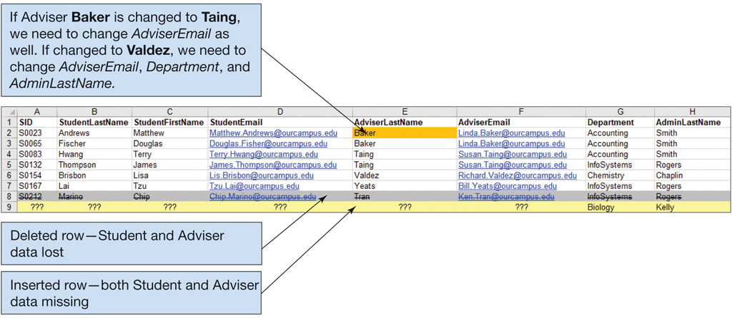
Figure 1.7 The Student with Advisor and Department List
Understand the potential problems with lists
A major problem with using lists include:
Modification problems: Redundancy and multiple themes can create modification problems such as deleting, updating, and inserting records as seen in the figure below.
Excel 2019, Windows 10, Microsoft Corporation.

Slide 9
Using Relational Database Tables
Understand how using related tables helps you avoid the problems of using lists.
Relational model is a methodology used as a solution for database design.
A relational database contains a collection of separate tables.
A table holds data about only one theme.
Each column, also known as fields, in a table stores a characteristic common to all rows in a table. An example is StudentNumber.
A row in a table, also known as a record, has data about an occurrence. An example would be all the information on one student.

Slide 10
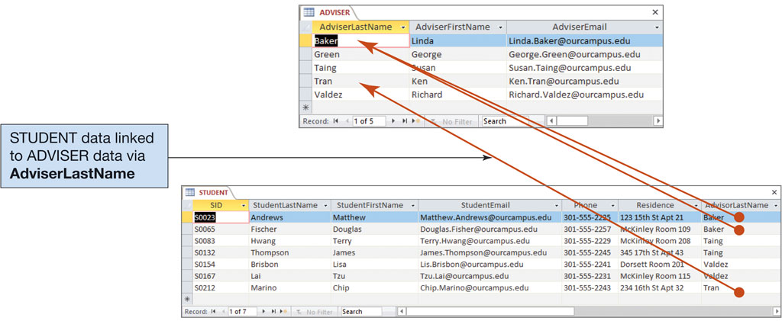
Figure 1.8 The Advisor and Student Tables
Access 2019, Windows 10, Microsoft Corporation.

Slide 11
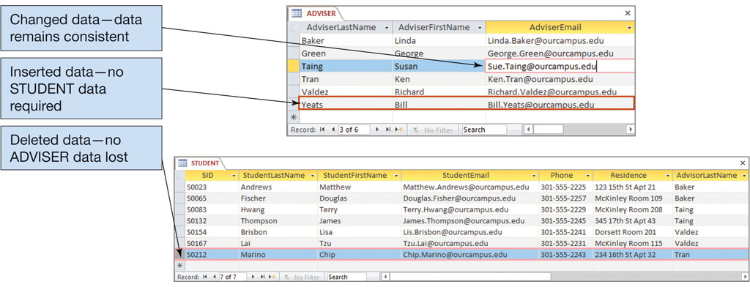
Figure 1.9 Modifying the Advisor and Student Tables
Access 2019, Windows 10, Microsoft Corporation.

Slide 12
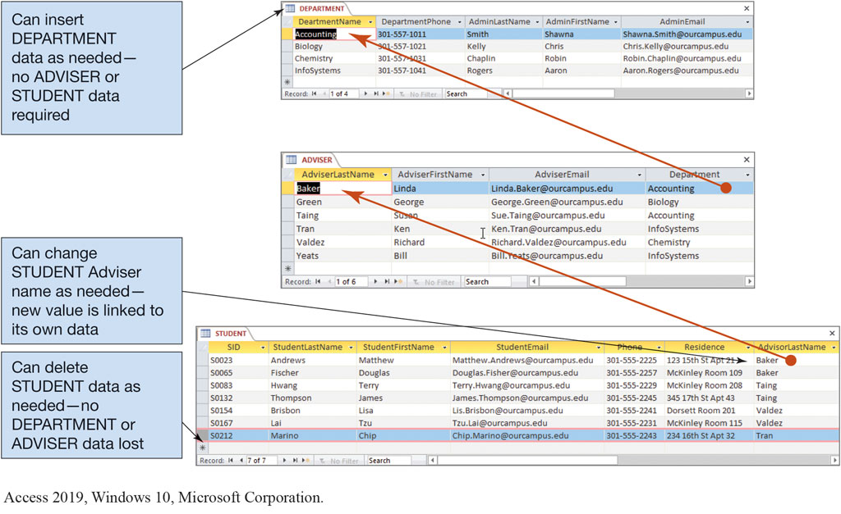
Figure 1.10 The Department, Advisor, and Student Tables
Access 2019, Windows 10, Microsoft Corporation.

Slide 13
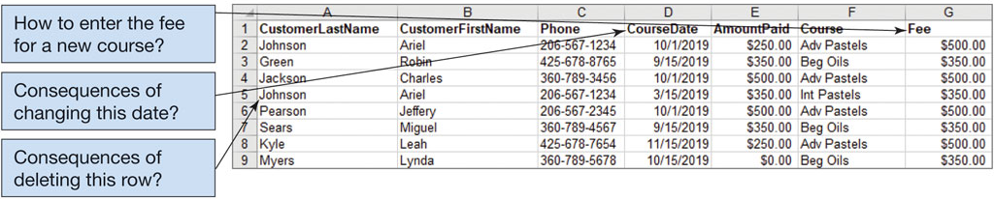
Figure 1.11 The Art Course List with Modification Problems
Excel 2019, Windows 10, Microsoft Corporation.

Slide 14
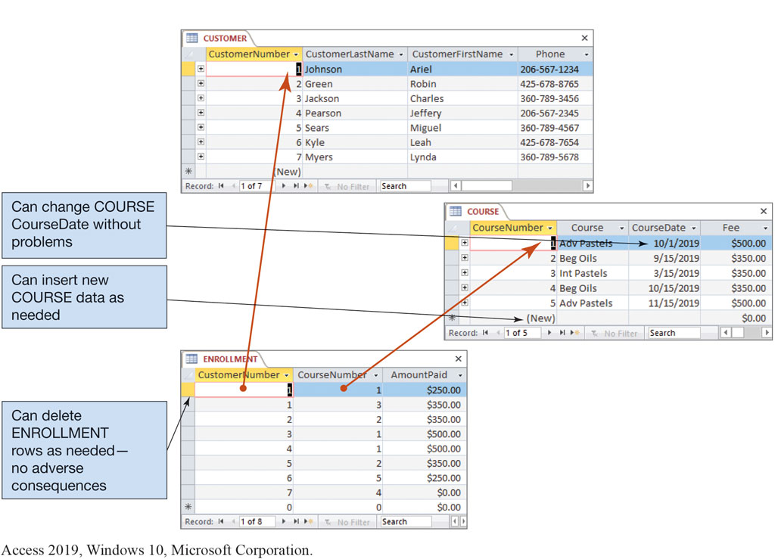
Figure 1.12 The Art Course Database Tables
Access 2019, Windows 10, Microsoft Corporation.

Slide 15
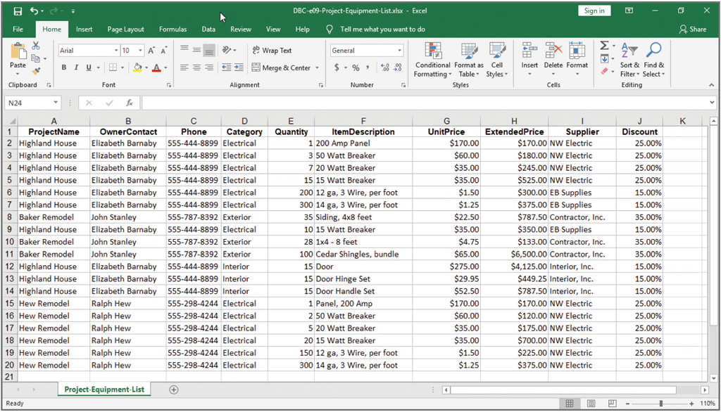
Figure 1.13 The Project Equipment List as a Spreadsheet
Excel 2019, Windows 10, Microsoft Corporation.

Slide 16
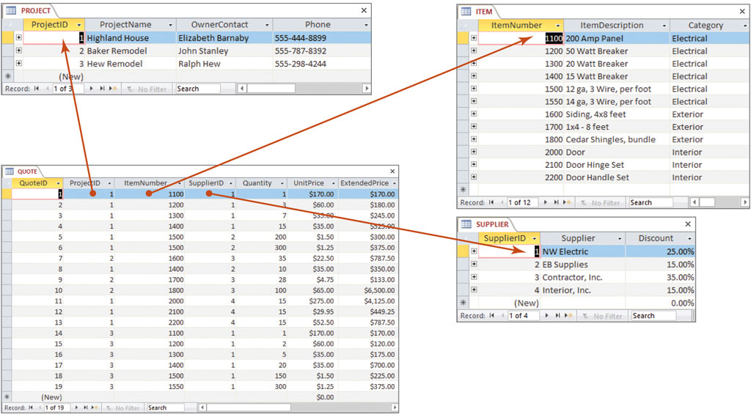
Figure 1.14 The Project Equipment Database Tables
Access 2019, Windows 10, Microsoft Corporation.

Slide 17
How do I Process Relational Tables Using S Q L?
The leading technique for data definition and manipulation is Structured Query Language (S Q L).
S Q L is an international standard for creating, processing, and querying databases and their tables.
Using S Q L you can:
Reconstruct lists from their underlying tables,
Query for specific data conditions,
Perform calculations on data in tables, and
Insert, update, and delete data.

Slide 18
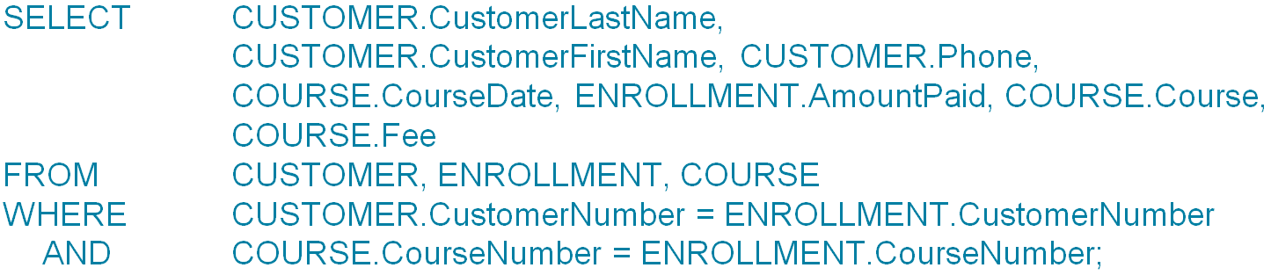
S Q L Art Course Database Example
Understand how using related tables helps you avoid the problems of using lists
Using S Q L, the following code will combine the three tables in the Art Course Database as seen in Figure 1.12:
The results of running the code above can be seen in Figure 1.15 on the next page.

Slide 19
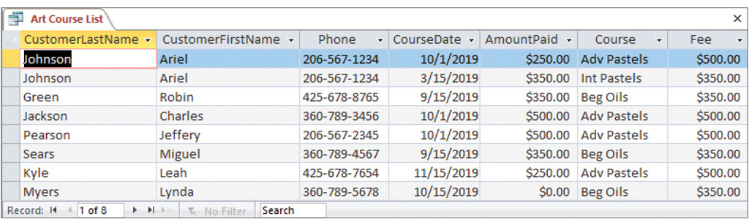
Figure 1.15 Results of the S Q L Query to Recreate the Art Course List Data
Access 2019, Windows 10, Microsoft Corporation

Slide 20
What is a Database System?
Know the components of a database system
A database system has four components consisting of:
Users,
Database application
Database management system (D B M S), and
Database.

Slide 21
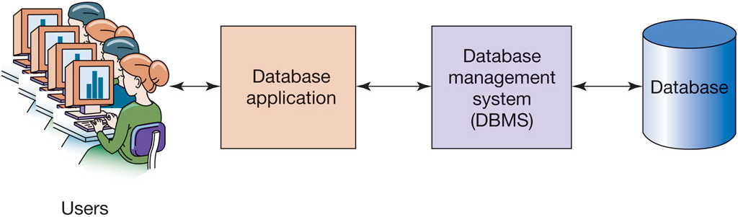
Figure 1.17 Components of a Database System

Slide 22
The Database
Know the components of a database system
A user of a database system will:
Employ a database application to keep track of things
Use forms to read, enter, and query data
Produce reports
A database is a self-describing collection of related tables:
Self-describing means a description of the structure of the database is contained with the database itself.
Metadata is data about the structure of the database.

Slide 23
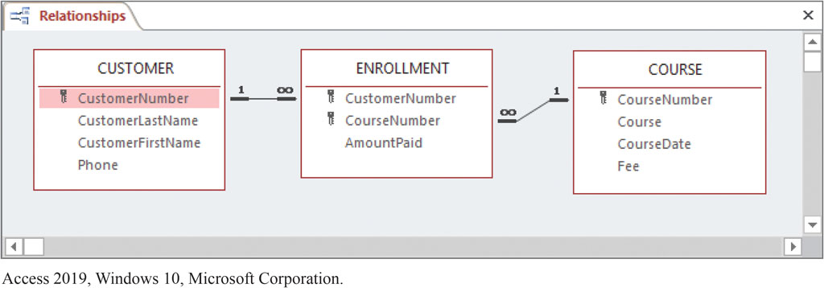
Figure 1.18 Example Metadata: A Relationship Diagram for the Art Course Tables in Figure 1.12
Access 2019, Windows 10, Microsoft Corporation.

Slide 24
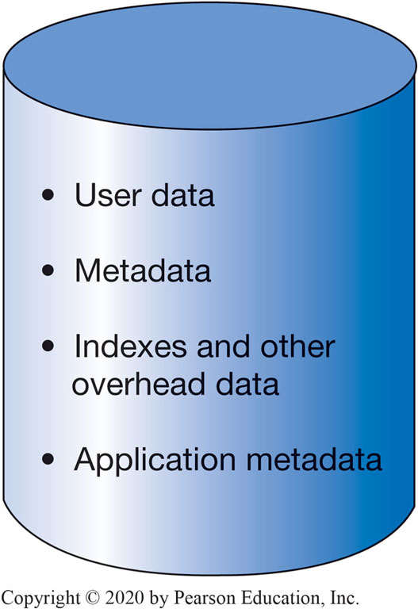
Figure 1.19 Database Contents

Slide 25
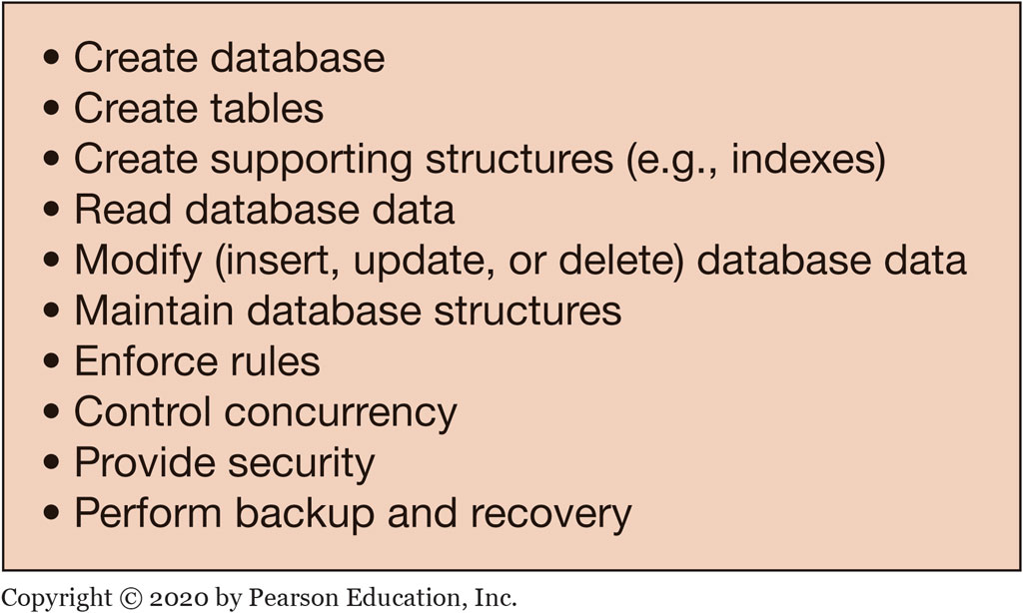
Figure 1.20 Functions of a D B M S
Learn to purpose of a database management system (D B M S)
The purpose of a D B M S is to create, process, and administer databases and are licensed from a vendor.
The functions of a D B M S are shown in the following slide:

Slide 26
Referential Integrity Constraints
Learn the purpose of a database management system (D B M S)
Referential integrity constraints are rules enforced by the D B M S to ensure values of a column in one table are valid when compared to values in another table.
For example, in the Art Course database what would happen if a user mistakenly entered 9 for CustomerNumber in the ENROLLMENT table?
Since 9 does not exist in that table it would cause errors and not execute.
To prevent this situation, the D B M S enforces the rule that if a CustomerNumber is entered in the ENROLLMENT table, must also exist in the CUSTOMER table.

Slide 27
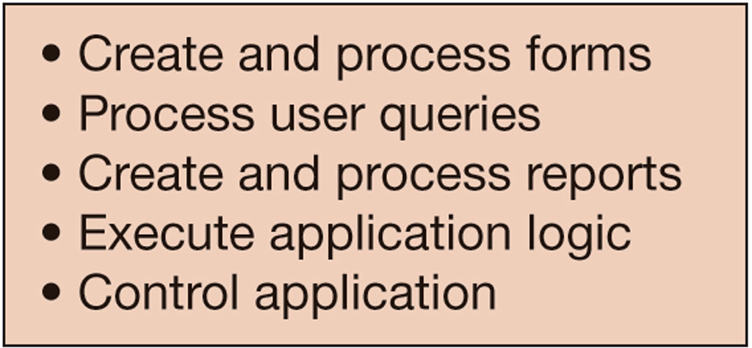
Figure 1.21 Functions of Database Application Programs

Slide 28
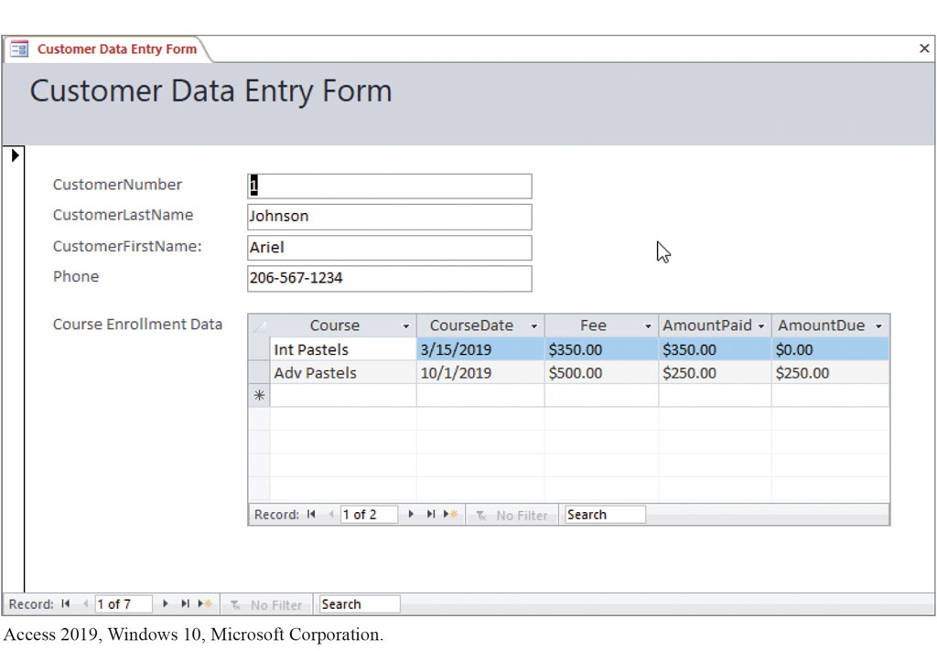
Figure 1.22 Example Data Entry Form
Access 2019, Windows 10, Microsoft Corporation.

Slide 29
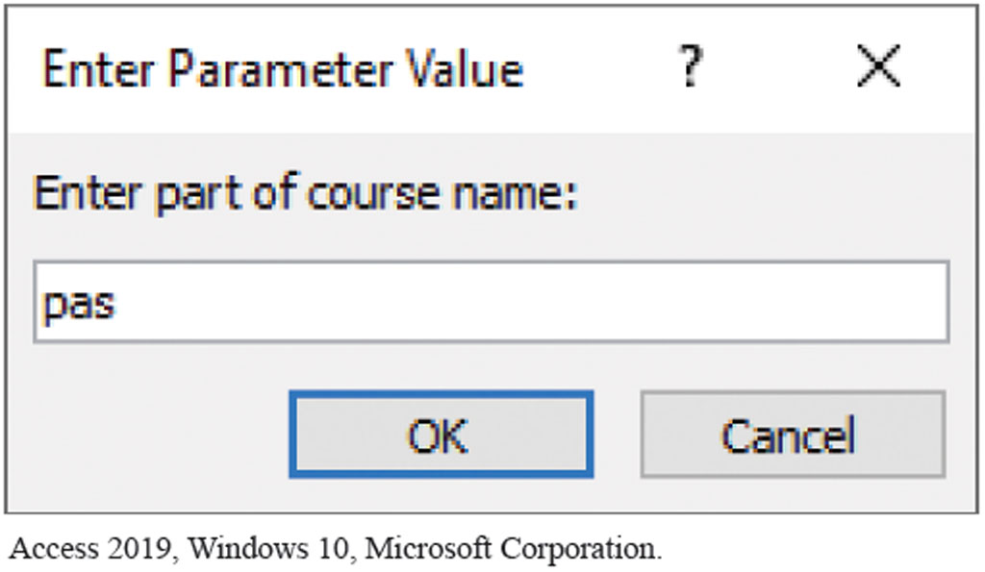
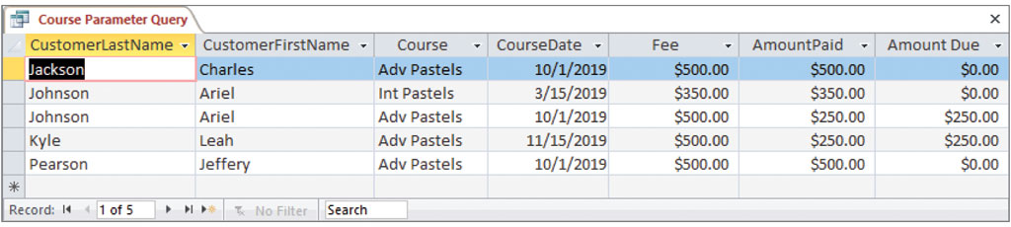
Figure 1.23 (a) Query Parameter Form, and (b) Query Results
Access 2019, Windows 10, Microsoft Corporation.

Slide 30
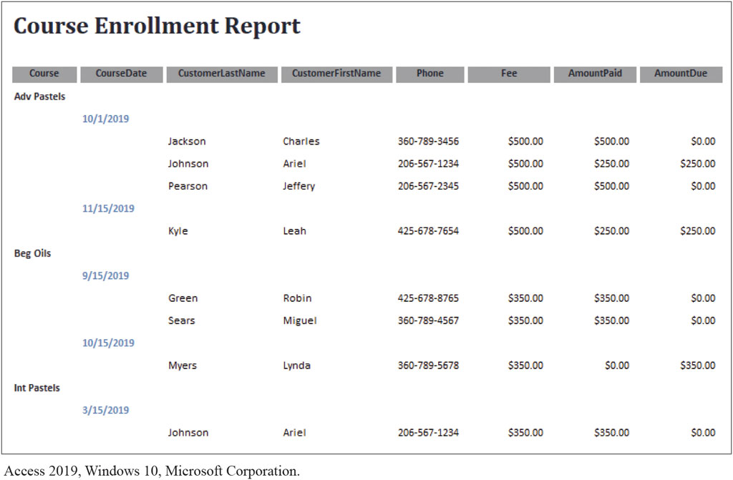
Figure 1.24 Example Report
Access 2019, Windows 10, Microsoft Corporation.

Slide 31
Personal vs. Enterprise-Class Database Systems
A personal database system is used by only one person and would include:
Only a few tables containing only a few hundred rows of data
Use only one computer with one user at a time
An enterprise database system is used international organizations with thousands of concurrent users and would include:
Hundreds of tables with millions of rows of data
In use 24/7 24 hours a day

Slide 32
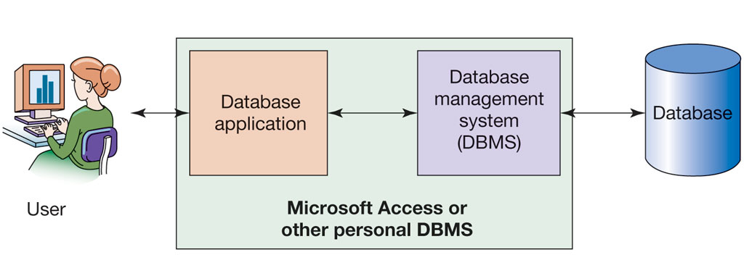
Figure 1.25 Personal Database System

Slide 33
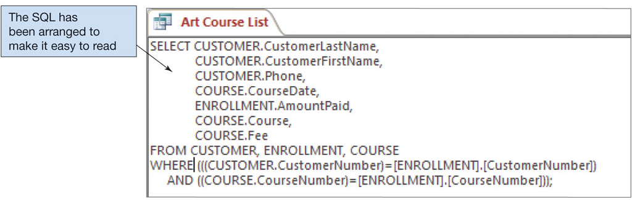
Figure 1.26 S Q L Generated by Microsoft Access Query
Access 2019, Windows 10, Microsoft Corporation.

Slide 34
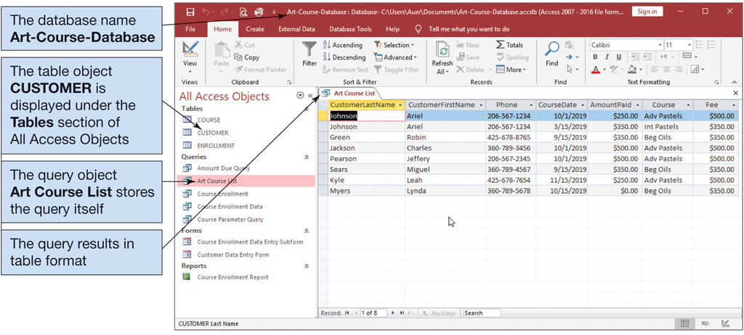
Figure 1.27 Microsoft Access 2019
Access 2019, Windows 10, Microsoft Corporation.

Slide 35
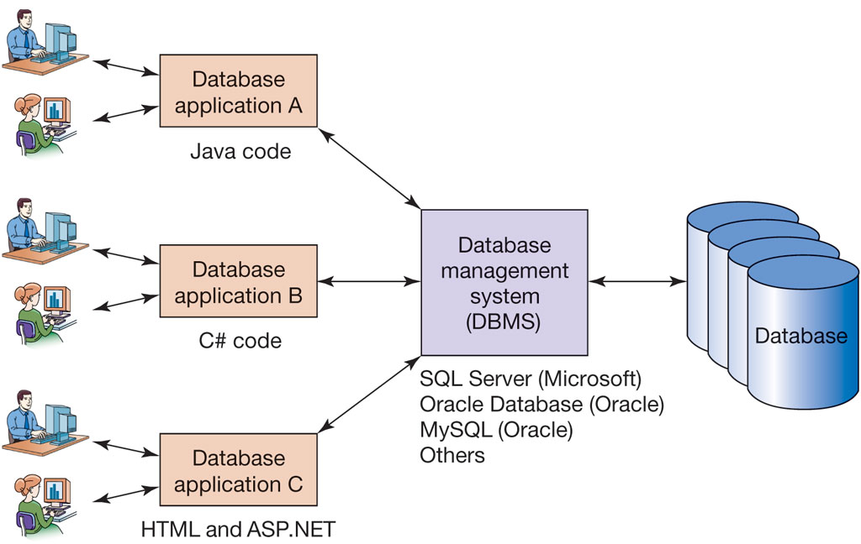
Figure 1.28 Enterprise-Class Database System

Slide 36
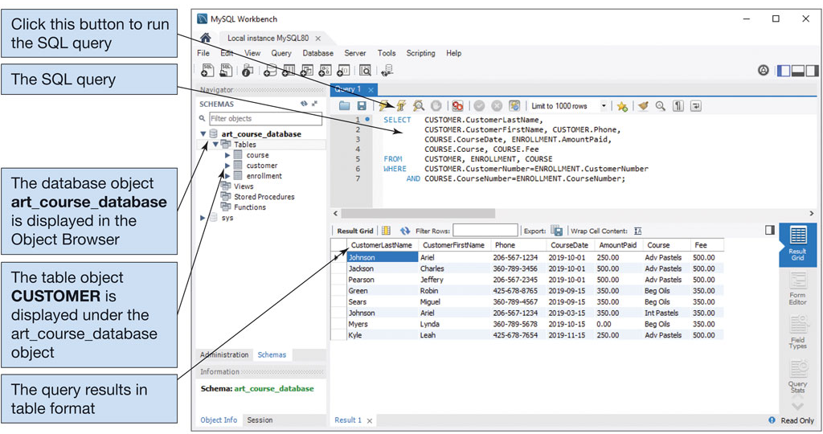
Figure 1.29 My S Q L 8.0
My S Q L Community Server 8.0, My S Q L Workbench, Oracle Corporation.

Slide 37
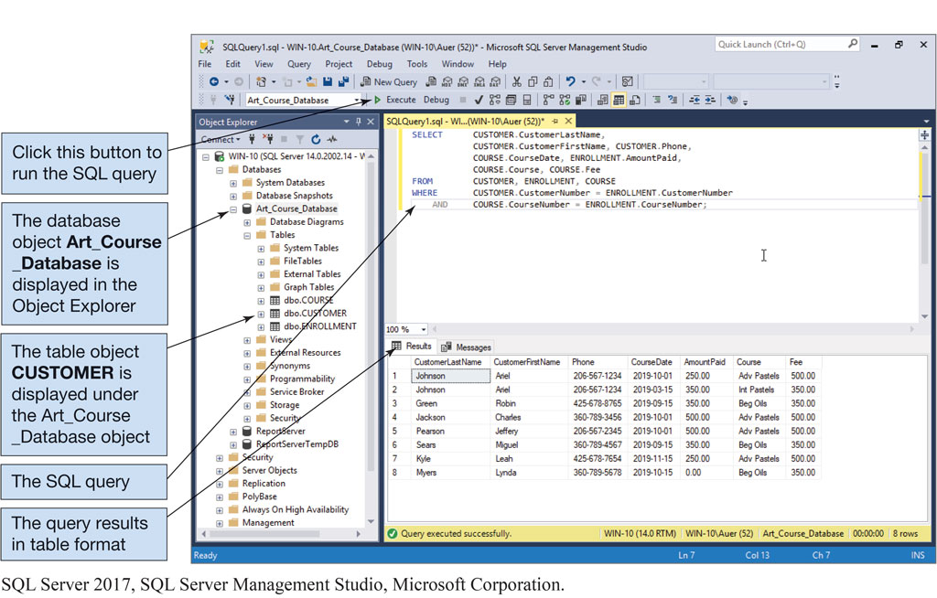
Figure 1.30 Microsoft S Q L Server 2017
S Q L Server 2017, S Q L Server Management Studio, Microsoft Corporation.

Slide 38
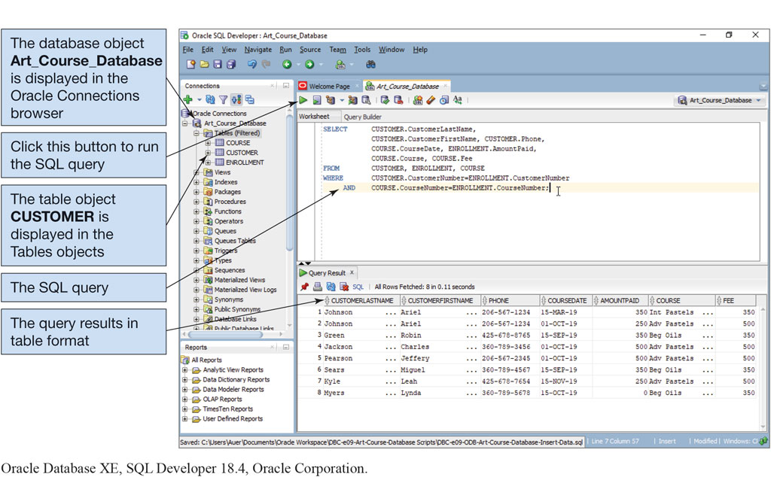
Figure 1.31 Oracle Database X E
Oracle Database X E, S Q L Developer 18.4, Oracle Corporation.

Slide 39
What is a Web Database Application?
Introduce Web database applications
A Web database application is an application with a Web user interface that is dependent on a database to store the data needed by the application (see Figure 1.32).
An application programming interface (A P I) is a programming language such as P H P or JavaScript to connect to a D B M S allowing the sending of S Q L commands to the D B M S and then to receive them back.

Slide 40
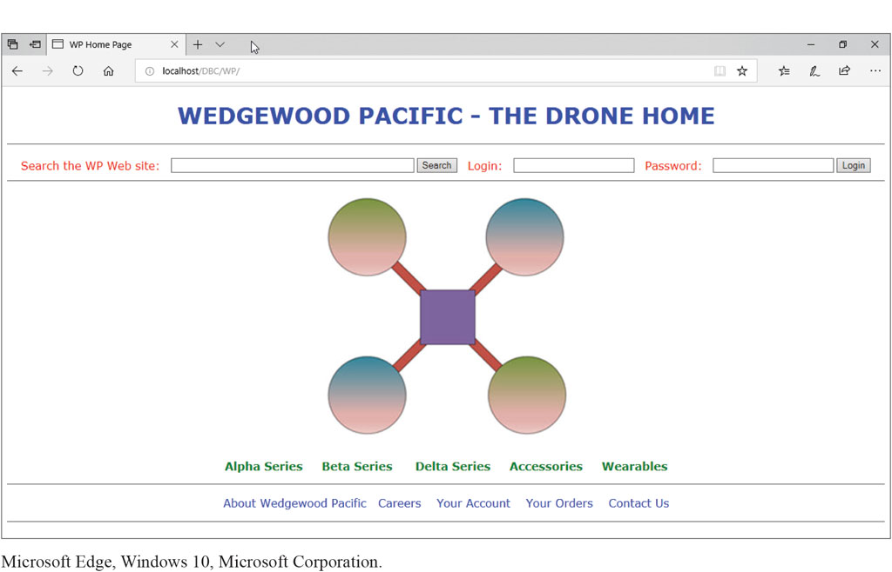
Figure 1.32 The W P Web Page
Microsoft Edge, Windows 10, Microsoft Corporation.

Slide 41
What are Data Warehouses and Business Intelligence (B I) Systems?
Introduce data warehouses and business intelligence (B I) systems
Transactions are purchases bought online that are recorded in a company’s database, also referred to as an online transaction processing (O L T P) database.
Data analysis is done on an organization’s online analytical processing (O L A P) database and is used for research.
A business intelligence system consists of tools used to analyze and report on company data.

Slide 42
What is Big Data?
Introduce Big Data and cloud computing
Big Data is the current term for the enormous datasets generated by Web and mobile applications.
Nonrelational databases are used to store Big Data (also known as No S Q L).

Slide 43
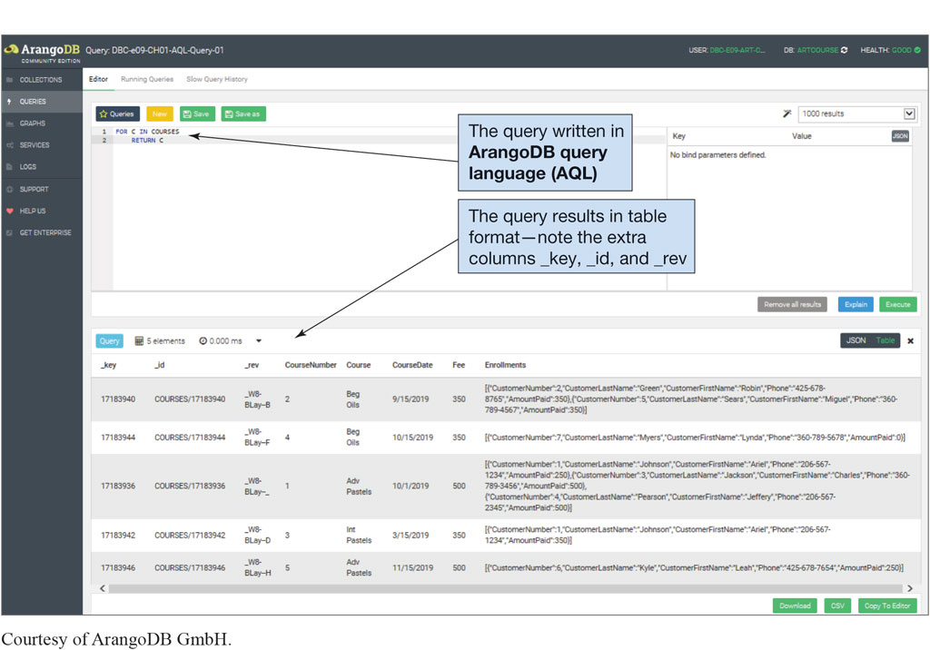
Figure 1.33 ArangoD B
Courtesy of ArangoD B G m b H.

Slide 44
What is Cloud Computing?
Introduce Big Data and cloud computing
Cloud Computing is the use of another company’s hardware to conduct business via an Internet connection or through a Web server.
Examples include:
Amazon Web Services (A W S)
Google Cloud Platform

Slide 45
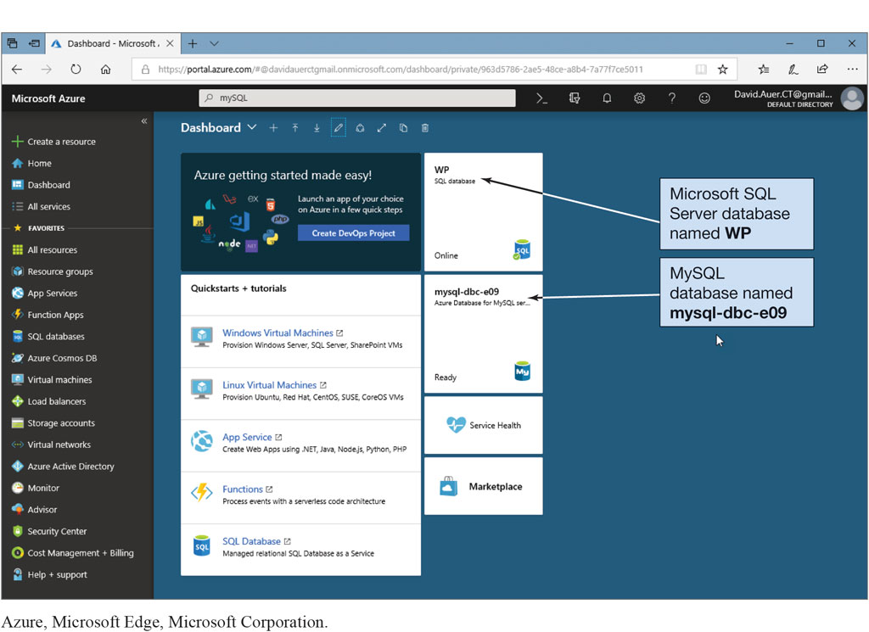
Figure 1.34 Microsoft Azure Cloud Service
Azure, Microsoft Edge, Microsoft Corporation.

Slide 46

Copyright
This work is protected by United States copyright laws and is provided solely for the use of instructors in teaching their courses and assessing student learning. Dissemination or sale of any part of this work (including on the World Wide Web) will destroy the integrity of the work and is not permitted. The work and materials from it should never be made available to students except by instructors using the accompanying text in their classes. All recipients of this work are expected to abide by these restrictions and to honor the intended pedagogical purposes and the needs of other instructors who rely on these materials.

